Slide 1





PREVENTIVE MONITORING
of the project
619451-EPP-1-2020-1-NL-EPPKA2-CBHE-IP
INTERNATIONAL STUDENTS
ADAPTATION AND INTEGRATION/
INTERADIS
MARIUPOL STATE UNIVERSITY
mdu.in.ua

Slide 2
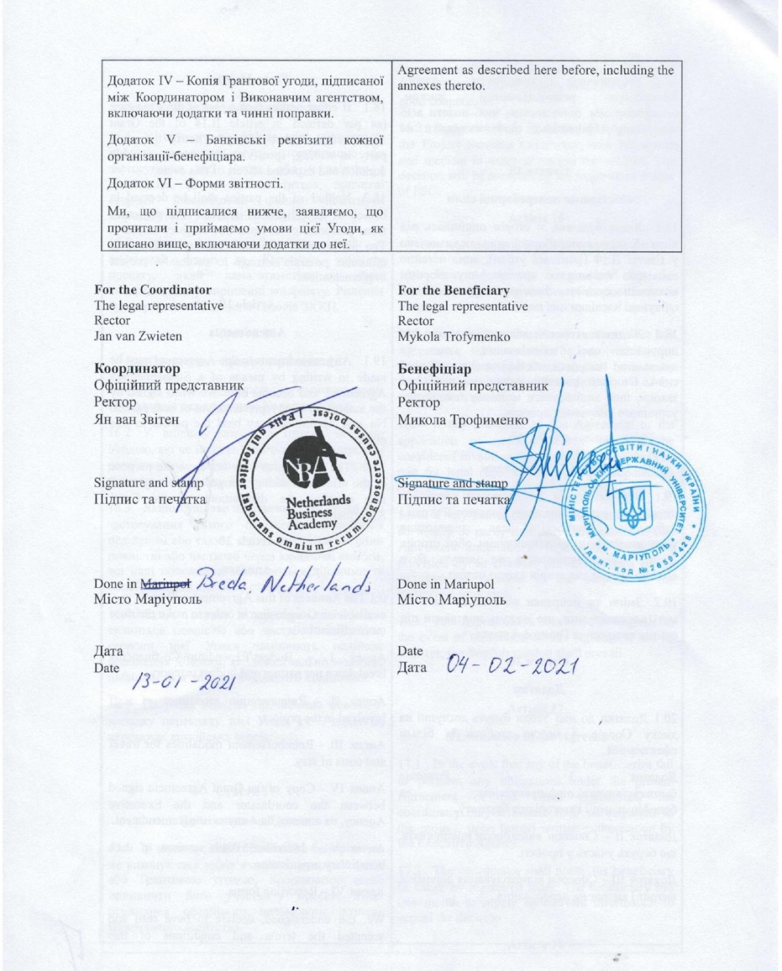
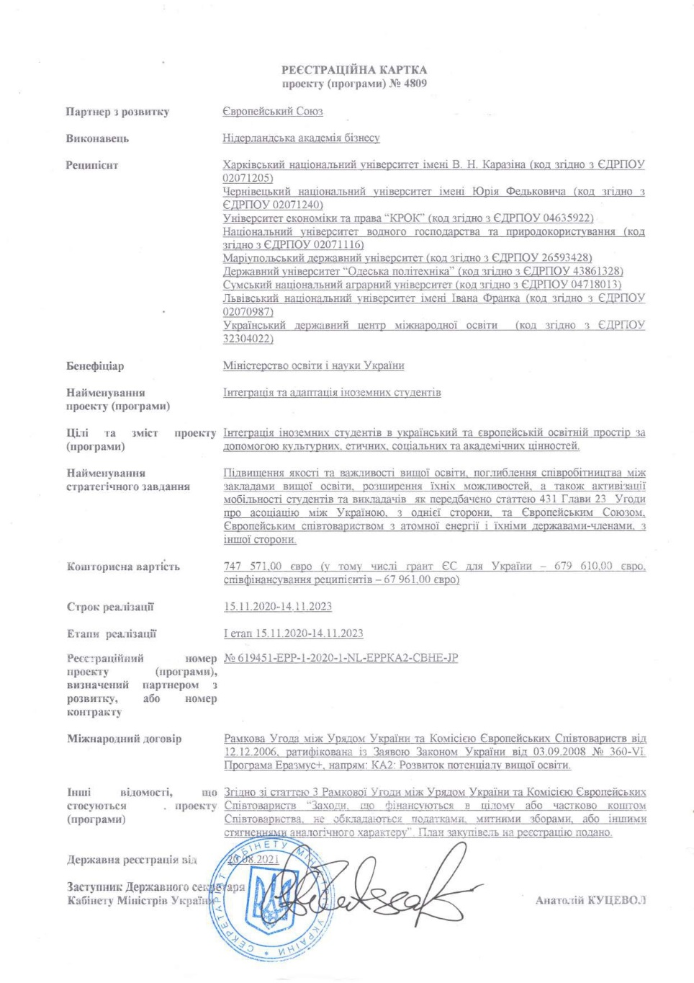
Project legal bases
Partnership agreement
State project registration
mdu.in.ua

Slide 3
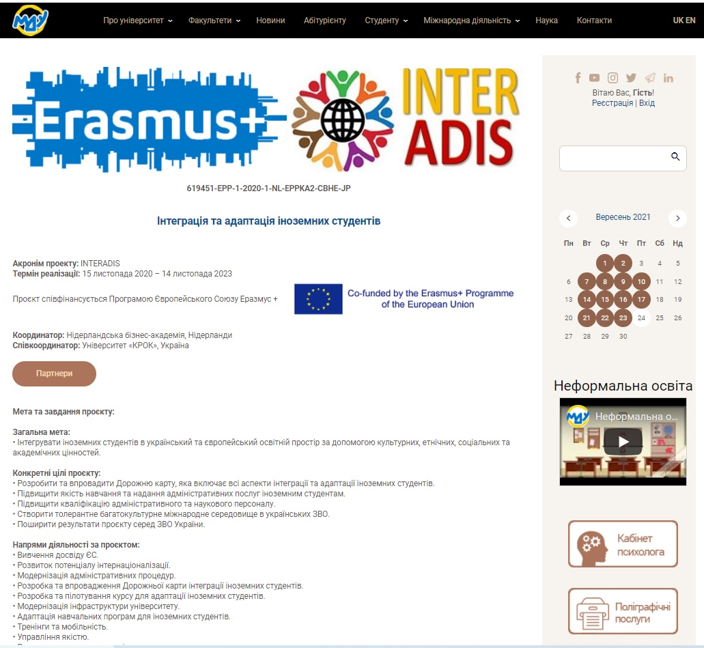
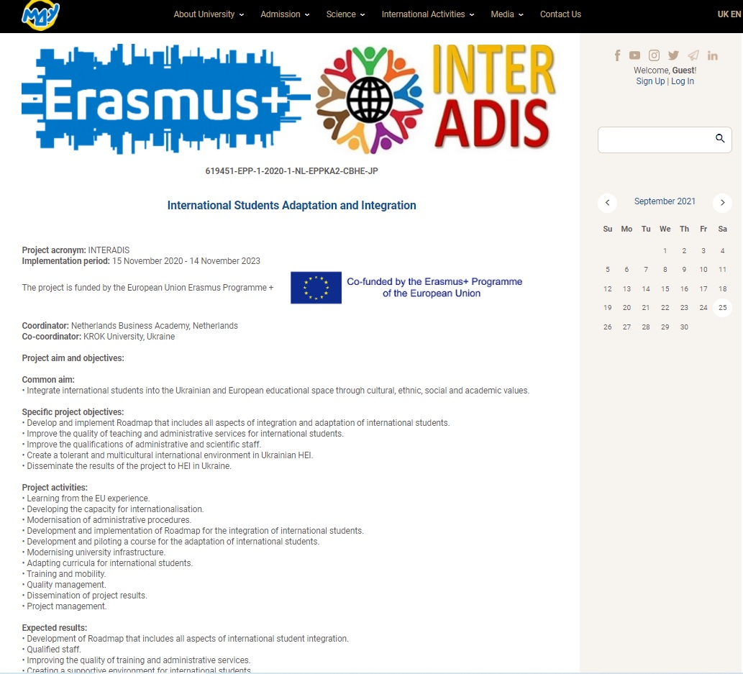
Information about INTERADIS at the website of Mariupol State University
mdu.in.ua

Slide 4
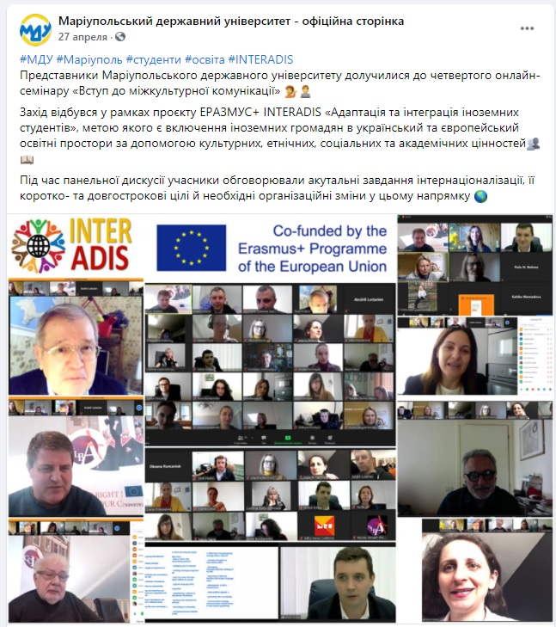
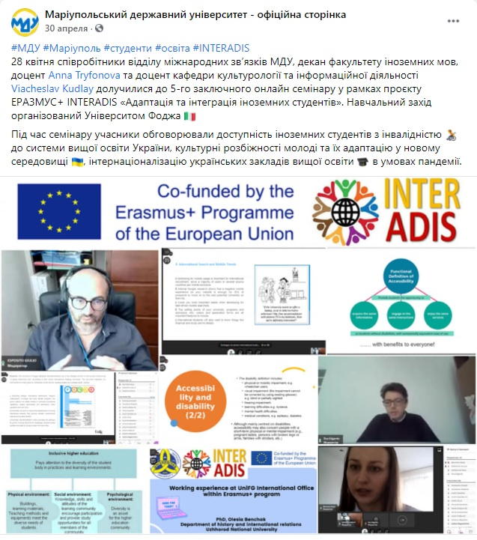
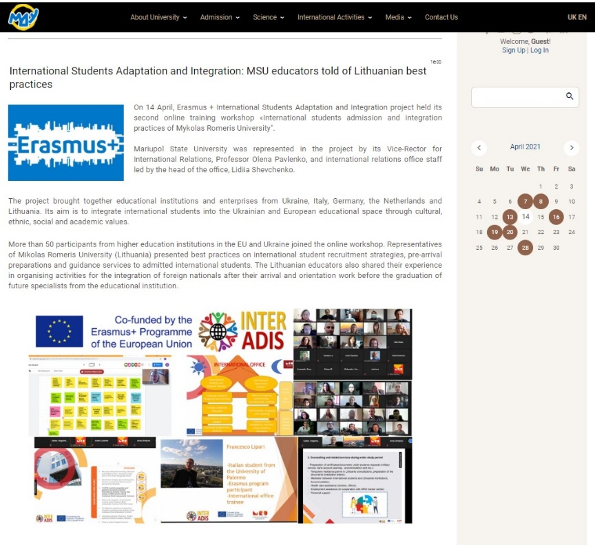
PROJECT IMPLEMENTATION
Online Study Visits
News on SV 1 HUG | http://mdu.in.ua/news/integracija_inozemnikh_studentiv_mdu_perejmae_dosvid_vid_evropejskikh_zakladiv_vishhoji_osviti/2021-04-07-3890 http://en.mdu.in.ua/news/international_students_adaptation_and_integration_msu_adopts_experience_from_european_higher_education_institutions/2021-04-07-312
News on SV 2 MRU | http://mdu.in.ua/news/integracija_inozemnikh_studentiv_osvitjanam_mdu_rozpovili_pro_krashhi_litovski_praktiki/2021-04-14-3891 http://en.mdu.in.ua/news/international_students_adaptation_and_integration_msu_educators_told_of_lithuanian_best_practices/2021-04-14-313
News on SV 1 OTH Amberg Weiden | http://mdu.in.ua/news/integracija_inozemnikh_studentiv_mdu_diznavsja_pro_krashhi_nimecki_praktiki/2021-04-16-3895 http://en.mdu.in.ua/news/international_students_adaptation_and_integration_msu_learns_about_best_german_practices/2021-04-16-314
News on SV 1 NLBA | http://mdu.in.ua/news/integracija_inozemnikh_studentiv_osvitjani_mdu_perejnjali_dosvid_koleg_iz_niderlandiv/2021-04-20-3893 http://en.mdu.in.ua/news/international_students_adaptation_and_integration_msu_educators_learn_from_the_experience_of_colleagues_in_the_netherlands/2021-04-20-315 https://www.facebook.com/mdu.mariupol/posts/3651495078305854
News on SV 1 UNIFG | http://mdu.in.ua/news/integracija_inozemnikh_studentiv_osvitjani_mdu_diznalisja_pro_krashhi_italijski_praktiki/2021-04-28-3894 http://en.mdu.in.ua/news/international_students_adaptation_and_integration_msu_educators_learn_about_best_italian_practices/2021-04-28-316 https://www.facebook.com/mdu.mariupol/posts/3660125034109525
Total number of involved participants: 10
mdu.in.ua

Slide 5
PROJECT IMPLEMENTATION
Financial Management.
- In March 2021 Mariupol State University received the first tranche of the project funding for salary, travel and accommodation expenses.
- Financial resources have not been used yet.
- The university prepared list of equipment necessary for the project implementation and for co-working space creation. The coworking space will help international students to integrate and adapt better to a new country.
TOTAL COSTS: 78515,00 EUR
- Staff costs - 19265,00 EUR
- Travel costs - 151490,00 EUR
- Costs of stay - 32 260,00 EUR
- Equipment costs - 10 000,00 EUR
- Subcontracting costs - 1 500,00 EUR
mdu.in.ua

Slide 6

PROJECT IMPLEMENTATION
Adaptation Course Development for International Students
Mariupol State University is responsible for chapter “Rights and Responsibilities for International Students” .
Adaptation course will be represented at the Moodle platform.
Video lectures are under preparation.
mdu.in.ua

Slide 7
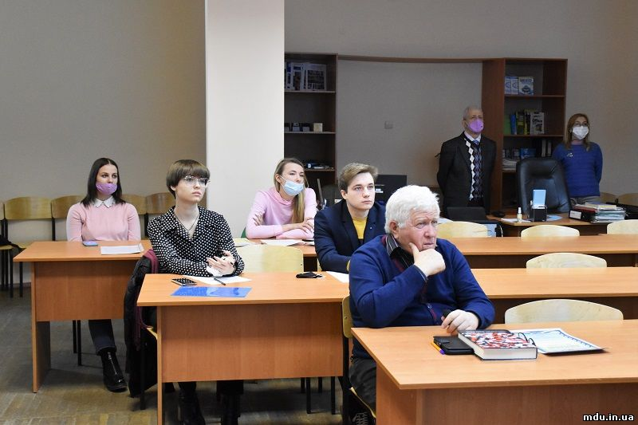
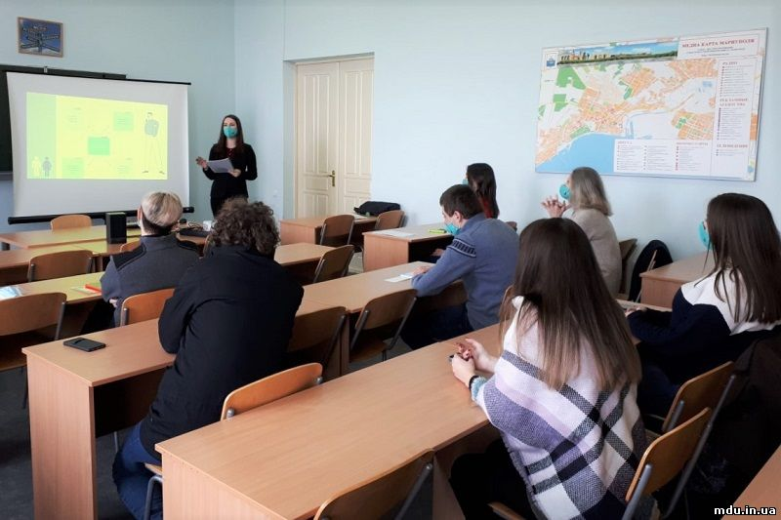
LANGUAGE COURSES FOR ADMINISTRATIVE AND ACADEMIC STAFF
From October 2021 a group of administrative and academic staff will learn English language.
The expected results: preparation of study course in English.
mdu.in.ua

Slide 8
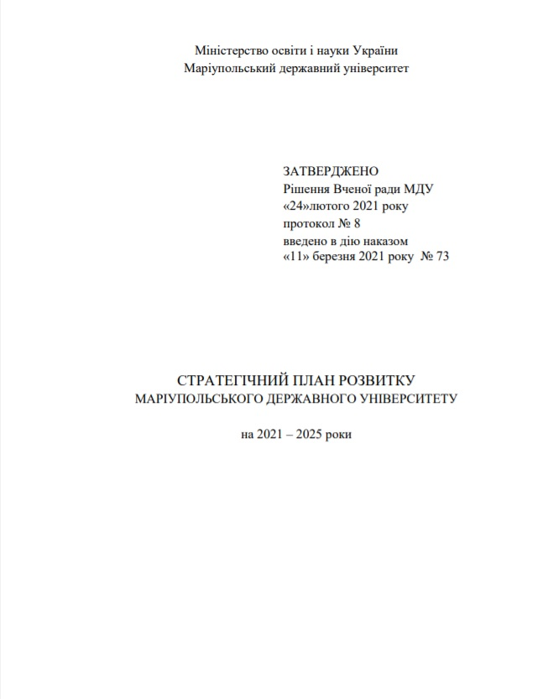
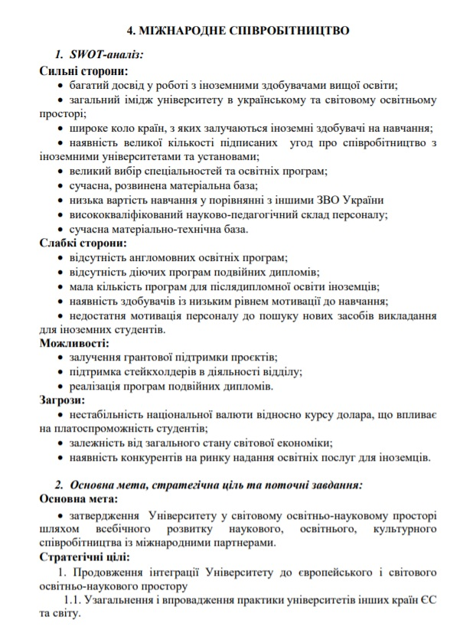
PROJECT IMPLEMENTATION
Modernization of administrative procedures.
Internationalization is a key part of Strategic Plan of Mariupol State University Development for 2021-2025.
Reorganization of International Relations Office to Centre of International Education.
Conception of English language development at Mariupol State University was approved.
Digitalization of university recruitment, admission, enrolment and academic processes.
Implementation of buddy program.
Implementation of Adaptation Week.
mdu.in.ua

Slide 9
SUSTAINABILITY OF PROJECT RESULTS
Internationalization
Approval of the University in the world educational and scientific space through comprehensive development of scientific, educational, cultural cooperation with international partners.
Achievement of international quality standards of education; curricula harmonization with the curricula of leading European universities according to the relevant educational programs.
Development and publishing of various publications and e-forms for coverage of the results of educational and research activities of the University to improve the image of Ukraine, the region and the University in the world and national educational and scientific spaces.
Increasing participation of teachers and students in various grants projects and programs of international organizations.
Development and implementation of a set of measures to increase the number of international students.
mdu.in.ua

Slide 10





MSU INTERNATIONAL PROJECTS
mdu.in.ua

